Slide 1
MALLARD CREEK HIGH SCHOOL JUNIOR PARENT NIGHT Thursday, January 29, 2015
CLASS of 2015

Slide 2
Graduation Requirements What are the CMS Graduation Requirements?
4 English
4 Math
3 Science
4 Social Studies
1 Health and Physical Education
8 Elective Credits (World Language, CTE, Art)
= 24 Total Credits (minimum)
Senior Project
CPR

Slide 3
Graduation Requirements What are the CMS Graduation Requirements?
Mathematics - 4 credits
Common Core Math 1
Common Core Math 2
Common Core Math 3
4th Math to be aligned with student’s post high school plans
Employment/2 Year College 4 Year College
Foundation Algebra Advanced Functions/Modeling
Foundation of Geometry Pre-Calculus
Pre-Calculus - Honors
AB/BC Calculus - AP

Slide 4
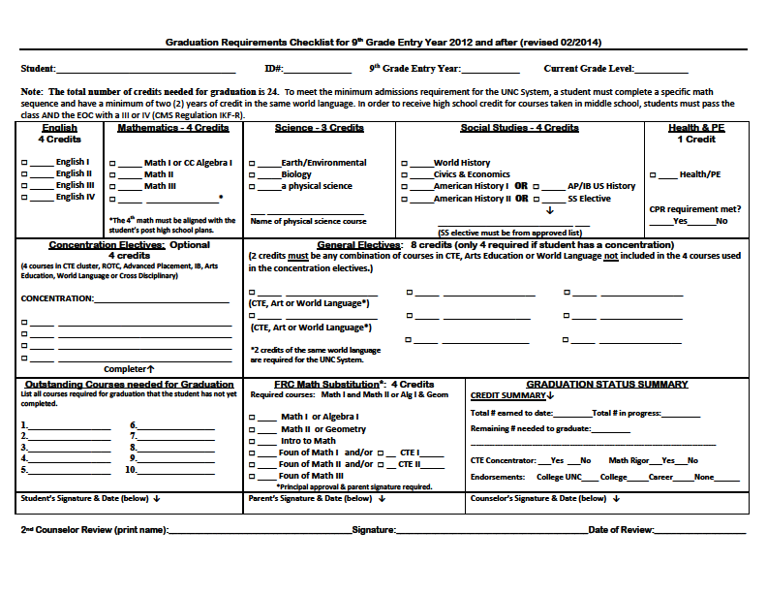

Slide 5
GPA, credits earned, class rank will be updated on February 18th

Slide 6
Post High School Academic Options
What are the different paths that students can take after high school?

Slide 7
POST HIGH SCHOOL OPTIONS
Did you know there are
3700 colleges in the US?
Community/Two Year Private Colleges (Associates Degree)
Public/Private Four Year Colleges/Universities
Specialized Institutions (art, music, culinary arts, technology, etc.)

Slide 8
POST HIGH SCHOOL OPTIONS
It’s all about the fit!
Location - distance from home, big city or small town
Size - Colleges range in size from 40,000 students to less than 1000 students
Cost - in state vs. out of state tuition, public vs. private
Selectivity - do you meet the admissions criteria for college /university, how competitive is admission
Type of college - private, public, community , coed vs. single sex
Housing - on/off campus, college dormitory, apartment, etc.
Diversity - gender, race, religion
Extra Curricular Activities - sports, sororities and fraternities, intramurals, clubs and volunteer opportunities
MOST IMPORTANT
Does it offer my choice of major(s)

Slide 9
COLLEGE ADMISSIONS
Admissions Options
Regular Decision: This is the most common admission option. It means that you turn in your application by the college’s deadline, and it lets you know by a specified date if you have been admitted or not.
Early Action: With Early Action, you send in your application earlier, and the college sends you its decision earlier. Make sure you read the instructions from each college carefully because some colleges have additional restrictions on their early action programs. Academically strong students will often apply to one Early Action school.
Early Decision: You can apply Early Decision to only one college. You are committing yourself to going to a particular school if you decide to apply Early Decision and are accepted (regardless of financial considerations). You should only apply Early Decision if you have a clear idea of your first-choice college. If you are looking at several colleges and don't want to limit your choices yet, Early Decision is not for you.
Rolling Admissions: There is no deadline for this option. Schools review and make decisions on applications as they receive them.

Slide 10
COLLEGE ADMISSIONS
APPLICATIONS DEADLINES
Early Decision / Early Action -
Usually Nov 1 or Nov 15
Regular Admission -
Often Jan 1st, but can be as early as Nov 30 or Dec 1st
Rolling Admission -
Anytime - The earlier, the better

Slide 11
COLLEGE ADMISSIONS
REACH – The student’s GPA and SAT / ACT scores fall below the historical averages for the college
MATCH– The student’s GPA and SAT / ACT scores fall within the historical averages for the college
HIGHLY LIKELY – The student’s GPA and SAT / ACT scores fall above the historical averages for the college and / or past ALB students

Slide 12
NC Colleges/Universities
University of nc Charlotte (UNCC)
Popular Majors: Business, Biology, Education, Engineering, Criminal Justice
Cost: $19,080.00 (2013-14)
Fall acceptance rate: 69%
NCAA Division 1
4 year Graduation Rate: 26 %
GPA: 3.6
Average ACT: 23
Average SAT: 1580
Selectivity: Selective

Slide 13
College Application Process
The Application
4 ways to submit it to the college
1) Use CFNC to apply to any 2 year or 4 year college in NC
2) Use the Common Application for over 500 colleges!
3) Complete the application online at the College Website
4) Download the application from the college website, fill it out and mail it back to them (RARE!)

Slide 14
College Planning What schools can/should I apply to? College Application Process
Paper applications vs. online applications
Check application deadlines
Send Transcripts
Send Test Scores
Request recommendation letters (as necessary, please allow at least 10 business days)
Pay Application fee

Slide 15
College Planning Resources
COLLEGE FOUNDATION OF NC
All 16 UNC institutions utilize the CFNC.org online applications system.
CFNC is the official system for sending high school transcripts electronically using
TRANSCRIPT MANAGER
www.cfnc.org
Plan. Apply. Pay

Slide 16
College Planning Resources
CFNC
COLLEGE APPLICATION WEEK
During NC College Application Week
most NC private colleges and universities as well as several NC state universities will entirely waive the application fee for all North Carolina high school seniors applying online through
CFNC.org
November 2015
(date to be announced)
Students sign up to participate in Guidance Office

Slide 17
Participating Schools
CFNC College Application Week
November 2014
All 58 NC Community Colleges
The following North Carolina Independent Colleges and Universities:
Barton College Lees-McRae College Salem College
Belmont Abbey College Lenoir-Rhyne University Shaw University
Bennett College Livingstone College St. Andrews University
Brevard College Louisburg College Mount Olive University
Cabarrus College Health Mars Hill College Warren Wilson College
Campbell University Meredith College William Peace University
Catawba College Methodist College Wingate University
Chowan College Montreat College
Davidson College NC Wesleyan College
Gardner-Webb University Pheiffer University
Guilford College Queen’s University
Johnson C. Smith University St. Augustine University
The following University of North Carolina Universities:
Fayetteville State University
North Carolina Central University
Winston Salem State University

Slide 18
College Planning Resources College Visitations
When? Fall/Winter of the senior year
Interviews with Admissions Counselors/Financial Aid Counselors
Campus Tours
Check out the freshman dormitories – visit the dining hall and the bookstore - attend a sporting event – think weekend activities – ask about intramurals – talk with other students
MC Seniors are allowed 2 excused visits to colleges per semester
(documentation required)

Slide 19
College Planning Resources College Visitations
Visits from admissions counselors are offered at Mallard Creek
Livingstone 2/9
Winston-Salem State 2/24
Fayetteville State (On-site Admissions) 2/26
CPCC 2/27
Visits take place primarily during the fall semester. Be sure to check the College Visit Registration Book in Guidance when you return to school in August.

Slide 20
College Admissions Testing
Do I need to take an
SAT or an ACT Test ?
*News to Note:
Report cards and PSAT scores will be distributed in homeroom on February 12th
ALL 11th grade students will take the ACT on March 3rd

Slide 21
College Admissions Testing Do I Need to take an SAT or ACT ? SAT vs. ACT – 4 Year College
SAT - Aptitude Test *1/4 point penalty for wrong answer
Critical Reading 33%
Math 33%
Writing Test 33%
ACT – Achievement Test *no penalty for wrong answer
English 25%
Math 25%
Reading 25%
Science 25%
Writing test is 25% (optional)

Slide 22
College Admissions Testing
Free or Reduced Lunch?
Students on Free or Reduced Lunch receive the following:
2 ACT Waivers ($109)
2 SAT Waivers ($105)
2 SAT Subject Test Waivers ($52)
4 CollegeBoard Application Waivers ($240+)
4 NACAC Application Waivers
NCAA Clearinghouse Waiver ($65)
NAIA Clearinghouse Waiver ($70)
Apply for free and reduced lunch - it could save you $641+

Slide 23
UNC System Quick Facts
For Students Entering Fall 2013
minimum GPA is 2.5
minimum ACT is 17 (composite)
minimum SAT is 800 (reading and math)
highly recommended that prospective students take a math course unit in grade 12
Meeting the minimum does not guarantee admission

Slide 24
NCAA Test Score Requirements
Test Scores
Division I has a sliding scale for test score and grade-point average.
Division II has a minimum SAT score requirement of 820 or ACT sum score of 68.
The SAT score used for NCAA purposes includes only the critical reading and math sections. The writing section of the SAT is not used.
The ACT score used for NCAA purposes is a sum of the four sections on the ACT: English, mathematics, reading and science. The writing section of the ACT is not used.
http://fs.ncaa.org/Docs/eligibility_center/Quick_Reference_Sheet.pdf

Slide 25
Scholarships and Financial Information
How do I pay for College?

Slide 26
Scholarships and Financial Aid Free Application for Federal and Student Aid (FAFSA)
Free Application for Federal Student Aid
Money given by the Federal Government to help students attend college.
Fill out the FAFSA starting January 1, 2016.
Applications can be filled out online at:
www.fafsa.ed.gov
All Students should fill this out - many colleges and universities require it despite family income.

Slide 27
Scholarships and Financial Aid What is a Scholarship?
Based on merit, financial need, community service, or sports.
Money that is awarded. (Do not have to pay back).
You don’t get them unless you apply.
They are work, but can pay off!
Link up with MCHS Student Services Scholarship Site!
http://mchsstudentservices.weebly.com/scholarship-info.html

Slide 28
Resources
www.cfnc.org – College Foundation of NC
www.commonapp.org – Common Application
www.collegeboard.com/ SAT
www.ACTstudent.org (ACT)
www.fafsa.ed.gov (financial aid)
www.collegeview.com (college searching)
www.college.gov (informational)
www.bls.gov/ooh (Federal Occupations
www.bigfutures.collegeboard.org
www.mymajors.com (help find the college match for you)
www.fastweb – financial aid and scholarships

Slide 29
Factors College Consider
Rigor of Academic Courses
Academic Performance and Grades
ACT and SAT Test Scores
Extra Curricular Activities
Essays
Letters of Recommendation
Demonstrated Interest (college visit)
Different colleges place weight on different factors

Slide 30
Grade 11 What should we be doing right now?
Begin the COLLEGE SEARCH process if not already started.
Take ACT and SAT tests in spring of Junior year.
Register for advanced and challenging courses for senior year.
KEEP GRADES UP - college application GPA usually based on grades from sophomore and junior years.

Slide 31
What To Focus On This Summer….
Finalize the college search, your college visits, and come prepared in the fall with your college list
Decide if you need to take one more SAT, ACT or Subject exam, if so, sign up ASAP for the September or October testing date
Review the Common Application and CFNC of NC
Start brainstorming/writing your college essays
Extracurricular activities/summer internships

Slide 32
Mallard Creek Student Services Website
Stay connected and follow us on the web!
Mallard Creek Student Services Weebly
http://mchsstudentservices.weebly.com/
or
Enter this number
9192465840
with this message
@mchsstud
for text information
Announcements - Scholarship Information -
College and Career Planning - Student Athletes
Student & Parent Resources - SAT/ ACT Information

Slide 33
MCHS Student Services Staff
Graduation Coach, Department Chair: Laronda Brown, laronda1.brown@cms.k12.nc.us
First Time 9th Grade Students: Charlene Jones, charlene1.jones@cms.k12.nc.us
A-E: Patti Stodghill, pattim.stodghill@cms.k12.nc.us
F-L: Cassie Walker, cassiel.walker@cms.k12.nc.us
M-R: Kristin Helms, kristinn.helms@cms.k12.nc.us
S-Z: Lorraine Stewart-Ayers, lorraine.stewart-ayers@cms.k12.nc.us
Career Development Coordinator: Rebecca White, rebecca.white@cms.k12.nc.us
Registrar: Katherine Palmieri, katherinet.palmieri@cms.k12.nc.us
Guidance Secretary: Cassandra Hunsucker, cassandra.hunsucker@cms.k12.nc.us
Attendance Secretary: Sandra Hajda, sandra.hajda@cms.k12.nc.us
School Psychologist: Leah Wade, leahr.wade@cms.k12.nc.us
School Nurse: Nurse "Cookie" Smith, darlene.smith@cms.k12.nc.us

