Slide 1
College Entrance Exams
PSAT/SAT
PACT/ACT

Slide 2
PSAT: Preliminary Scholastic Aptitude Test
The PSAT/NMSQT is more than just a test. It gives students:
Suggestions on how to improve academically
Give students personalized feedback on their test performance.
Preparation for the SAT®.
Opportunities to earn scholarships and academic recognition. For more information, go to Scholarships and Recognition.
Information from colleges and universities through Student Search Service®
A free personalized online college planning kit based on their test results. For more information, go to My College QuickStart™ and MyRoad™.

Slide 3
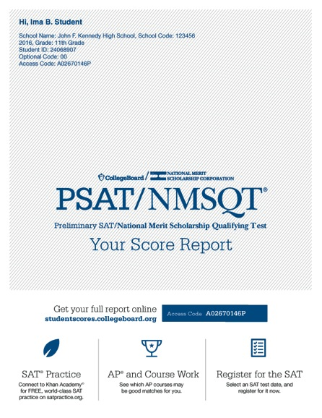
I Took It, Now What?
Scores for the assessments in the SAT® Suite are vertically equated.
Notes:
Ask students to find “Your Total Score” in the center of the score report. In the sample on the slide, the total score is 960. Total scores are based on a scale of 320 to 1520 on the PSAT/NMSQT. Inform students that this is the score they would likely receive on the SAT had they taken the SAT on the same day they took the PSAT/NMSQT because all of the scores for the assessments in the SAT Suite are vertically equated. The SAT total score ranges from 400 to 1600. Ask students to consider whether they would be satisfied with this SAT score if they were using it to apply for college.
On either side of “Your Total Score,” students will find their section scores. “Your Evidence-Based Reading and Writing Score” is on the left (430 on the slide), and is the scaled score they earned from the Reading Test and the Writing and Language Test combined. “Your Math Score,” to the right of the total score (530 on the slide), is the scaled score they earned from taking the Math Test. Both of these section scores are on a scale of 160 to 760 on PSAT/NMSQT, and are added together to get the total score. On the SAT, the range for these section scores is 200–800.
Below the Evidence-Based Reading and Writing Score, and below the Math Score, students will see where their scores fell on a graph between 160 and 760.
The colors on this graph represent the grade-level benchmark. Students who meet the grade-level benchmark are on track to meet the college readiness benchmark on the SAT. For their section scores, if the score falls in the red area of the graphic, they “need to strengthen their skills,” meaning they are more than one year below the grade-level benchmark. If the score falls in the yellow part of the graphic, they are “approaching benchmark,” or below the grade-level benchmark by one year or less. If the score falls in the green area of the graphic, they are on track for college readiness and have met or exceeded the benchmark.

Slide 4
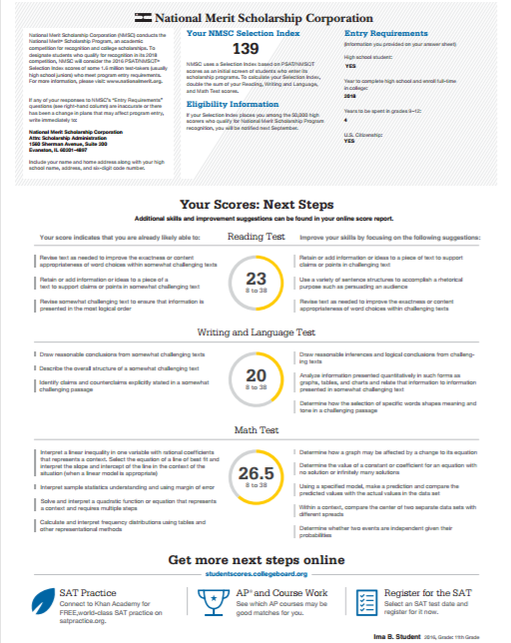
What Is the National Merit® Scholarship Program?
Notes:
The National Merit Scholarship Program is an academic competition for recognition and scholarships that began in 1955. Of the 1.5 million students who take the PSAT/NMSQT, some 50,000 with the highest PSAT/NMSQT Selection Index scores qualify for recognition in the National Merit Scholarship Program. In September, these high scorers are notified through their schools that they have qualified as either a Commended Student or a Semifinalist.
Selection Index scores are calculated by doubling the sum of the Reading, the Writing and Language, and the Math Test scores. Students can find this score in the middle of the top of page 3 of the paper score report. If there is an asterisk after the number, the student is not eligible for the competition during this test administration.
For more information, visit NMSC’s website or see the Official Student Guide to the PSAT/NMSQT or the Guide to the National Merit® Scholarship Program (for educators).

Slide 5
What Are My Areas of Strength? What Skills Do I Need to Build?
Your Scores: Next Steps
Notes:
The PSAT/NMSQT score report is intended to support students as they analyze their strengths and areas for growth on the road to college readiness. The “Skills Insight” portion of their report gives each student information about what they likely know and can do according to their test results, based on students who scored similarly. It also provides suggestions for areas that need work so that they can develop their knowledge and skills. Only a subset of their skills and suggestions are on the paper report; the full list is online.
“Your Scores: Next Steps” gives students more information about the knowledge and skills they have demonstrated, and the knowledge and skills on which they should focus for growth.
Ask students to write down the areas in which they can improve their skills (from the right side of the score), and then think about and commit to ways to work on those skills. Their plans might include practicing on Khan Academy or asking for help from a teacher. It might be assignments that teachers provide in their classes. It is helpful for the students to develop plans for skill development as they review their scores with their teachers.

Slide 6
Student Search Service®
Connects students with information about educational and financial aid opportunities.
Participate voluntarily.
Connect with more than 1,200 colleges, universities, scholarship programs, and educational organizations.
Sign up when you take an assessment in the SAT® Suite
Choose to participate in Student Search Service when registering for a College Board test (fill in the circle on the answer sheet).
Provide information about yourself on your answer sheet.
Participating organizations can then search for groups of students who may be a good fit.
FYI: The College Board never shares information on disabilities, parental education, self-reported parental income, Social Security numbers, phone numbers, or actual test scores through Student Search Service.
Notes:
Student Search Service is a voluntary program that connects students with information about educational and financial aid opportunities from more than 1,200 colleges, universities, scholarship programs, and educational organizations. Here’s how it works:
› Students may choose to participate in Student Search Service when registering for a College Board test.
› As part of taking the PSAT/NMSQT, students are asked to provide information about themselves on their answer sheet.
› Participating, eligible organizations can then search for groups of students who may be a good fit for their communities and programs, but only among those students who opt to participate in Student Search Service.
› The search criteria can include any attribute from the answer sheet; however, information on disabilities, parental education, self-reported parental income, Social Security numbers, phone numbers, and actual test scores are not shared. The most searched items are expected high school graduation date, cumulative grade point average (GPA), and intended college major. If students have questions or concerns about Student Search Service or want more information about the program, please tell them to go to collegeboard.org/student-search-service or to call 866-825-8051.
Here are some points to keep in mind about Student Search Service:
» Colleges participating in Student Search Service never receive student scores or phone numbers. Colleges can ask for names of students within certain score ranges, but exact scores are not reported.
» Being contacted by a college doesn’t mean you have been admitted. You must submit an application in order to be considered for admission. The colleges and organizations that participate want to find students who will fit their environment, classes, programs, scholarships, and special activities. Student Search Service is simply a way for colleges to reach prospective students like you and to let them know about the opportunities that are available.
» Student Search Service will share your contact information only with colleges and qualified nonprofit educational or scholarship programs that are recruiting students like you. Your name will never be sold to a commercial marketing firm or a retailer of merchandise or services (such as test prep). Student Search Service communications are sent by outside colleges, scholarship programs, and educational opportunity organizations

Slide 7
SAT: Scholastic Aptitude Test
One of the most widely used admissions tests
The SAT helps college admissions officers make fair and informed admission decisions. Combined with a student's academic record, it is a proven, reliable indicator of college success.
Tests the subject matter learned by students in high school and how well they apply that knowledge—the critical thinking skills necessary to succeed in college.

Slide 8
Why should students take the SAT?
Students and parents often ask why it is important to take the SAT. Reasons include:
All colleges accept the SAT as an objective measurement of students' college readiness.
Used with GPAs and high school transcripts, SAT scores allow colleges to fairly compare applicants.
Taking the SAT gives students access to scholarship opportunities. The SAT provides students with the most comprehensive performance feedback of any admission test.

Slide 9
The NEW SAT
The SAT was reformatted for the March 2016 test
Highest possible score is 1600
Test is comparable in nature to the ACT; fewer sections and essay is optional

Slide 10
PACT: Practice ACT for 10th Graders
PACT shows your strengths and weaknesses in English, Mathematics, Reading, and Science.
PACT lets you know if you’re on target for college.
PACT helps you find careers that match your interests.
PACT helps you prepare for the ACT.

Slide 11
What Will It Look Like? - Same score range as the ACT - World of Work Map - Breakdown of section performance

Slide 12
ACT: American College Test
Contains 5 curriculum-based tests: the English, Mathematics, Reading, and Science
Optional Writing section is an impromptu essay on a given prompt.
Tests are standardized multiple choice
Performance on these tests has a direct relationship to a student’s educational achievement.
Not all Universities “SuperScore” the ACT.
Schools That Superscore

Slide 13
ACT Score Report

Slide 14
The ACT at-a-Glance
2017 MCHS Scores
English
75 questions
45 minutes
Multiple Choice
1–36
15.7
Math
60 questions
60 minutes
Multiple Choice
1–36
18.1
Reading
40 questions
35 minutes
17.9
Multiple Choice
1–36
FORMAT/ TIME
Science
40 questions
35 minutes
Multiple Choice
1–36
17.6
Writing
1 essay
40 minutes
Essay (Optional)
2–12
5.5
4–5 Sections
2 hrs, 55 minutes
3 hrs, 25 minutes
MCHS:
17.4
Total:
1–36
Notes:
14

Slide 15
MCHS & The ACT
All 11th grade MCHS students will take the ACT
FOR FREE
on Tuesday, February 27, 2018 (Writing included)
This is a valid, reportable score.
Encourage your students to take it seriously.
Save your score report from the MCHS test. You will need the ACT student id number if you try to register for future tests.

Slide 16
Key Differences
 | SAT | ACT
# of Questions | 154 | 215
Length of Test | 3 hours | 2 hours 55 minutes
Fee Waivers | Test & College Application | Test Only
Structure | 3 Tests + Optional Writing | 4 Tests + Optional Writing
Cost | $46/$60 | $46/$62.50
SAT/ACT Score Comparison Chart
CollegeBoard ACT/SAT Comparisons

Slide 17
Common Misconceptions
Only take the ACT if you’re good at science.
Don’t send your scores to schools until you see them and know they are good.
Competitive schools only accept the SAT.
Not all schools will accept these scores.
Notes:
17

Slide 18
Mallard Creek Test Dates
October 11, 2017 PSAT Test
All 10th/11th graders
November 8, 2017 PACT Test
All 10th graders
February 27, 2018 ACT
All 11th graders

Slide 19
QUESTIONS?
Thank you!

